Slide 1
A MEDBIQ-SCORM Tutorial:
How to Develop Engaging E-Learning
That’s Easy to Find and Reuse
Nina Pasini & Dan Rehak, PhD
Learning Systems Architecture Lab
Carnegie Mellon University
Pittsburgh, PA 15213 USA
Web: http://www.lsal.cmu.edu/
Email: lsal@cmu.edu

Slide 2
Overview
Where does SCORM fit in the context of learning?
How does Medbiquitous make finding
e-learning content easier?
What do you need to know (and do) before designing SCORM content?
How do you design good SCORM content?
What does sequencing mean to
content design?

Slide 3
Where does SCORM fit in the context of learning?

Slide 4
SCORM versus Learning
SCORM is a technical document
Written for vendors and toolmakers
  What tools must do
  How systems must behave
Not (directly) for content designers and developers
  Not how to create learning experiences
  Not what makes good learning

Slide 5
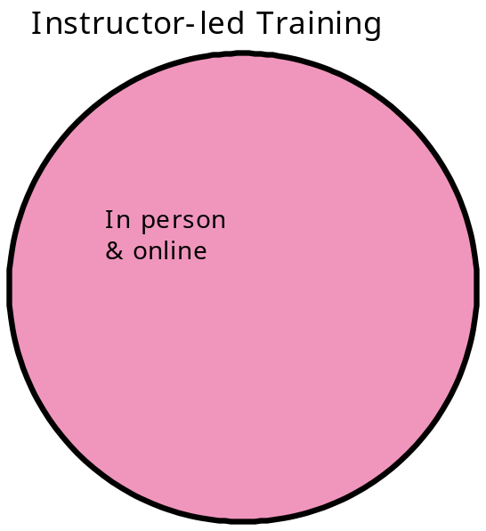
SCORM in the Context of Learning

Slide 6
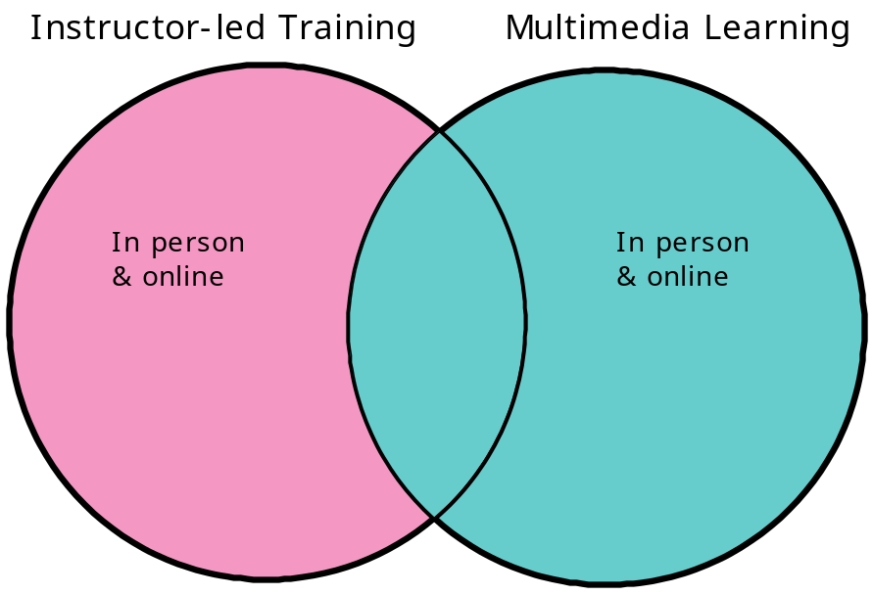
SCORM in the Context of Learning

Slide 7
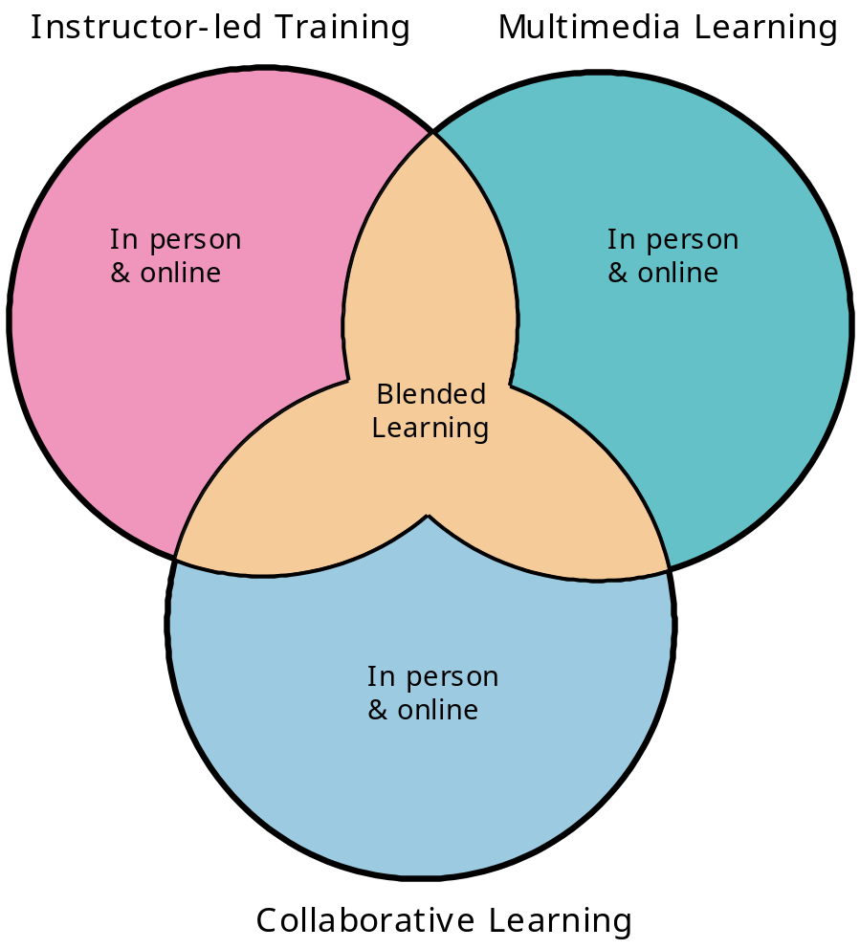
SCORM in the Context of Learning

Slide 8
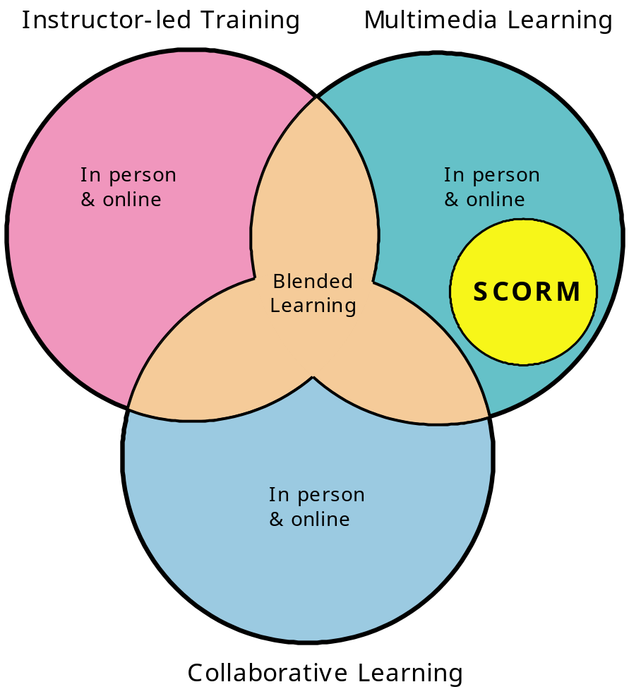
SCORM in the Context of Learning

Slide 9
How does Medbiquitous make finding e-learning easier?

Slide 10
Mandate for MEDBIQ-SCORM
The medical terminology is like,
really different from English.
President George Bush
Speaking at Better Healthcare 20040510

Slide 11
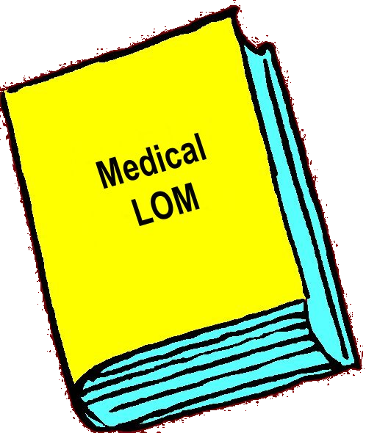
MEDBIQ-SCORM
Extension of SCORM
For medical community of practice
To represent unique needs of medical community
In managed learning

Slide 12
Definition of Metadata
“Data about data” - information that describes your content
  Title, Description, Objectives
  Delivery style, Intended Learners
  Creator and Copyright Information

Slide 13
Definition of Metadata
Enables those searching for content to locate it relatively easily in a content repository or content management system (LCMS)
  Internal users (developers, IDs, HR, managers, etc)
  External content searchers seeking to use your content

Slide 14

Basis of SCORM Metadata
Based on IEEE Learning Object Metadata
Standard (IEEE LOMv1.0)
Standardizes descriptive
metadata
Provides an object cataloging
scheme
Used for SCOs, packages, etc.
  Describes the Learning Object
Used only at authoring time – learner never sees the metadata

Slide 15
SCORM Metadata
Includes over 70 possible fields
  Most fields are not required by SCORM
  Your organization must determine and document
    Which fields you will use
    How you will use / populate each field

Slide 16
SCORM Metadata
Some fields have a predefined vocabulary list
  Select descriptive terms from a standardized list
  Ensure everyone uses the vocabulary the same way
Examples
5.8 Difficulty
  Very easy
  Easy
  Medium
  Difficult
  Very difficult
2.3.1 Role
  Author
  Publisher
  Unknown
  Validator
  Initiator
  Terminator…
1.7 Structure
  Atomic
  Collection
  Networked
  Hierarchical
  Linear

Slide 17
Customizing Metadata
Both SCORM and LOM are extensible
  Organizations can create their own schemas and taxonomies for metadata
  Once created, must be maintained

Slide 18
MEDBIQ-SCORM Metadata
Some fields have a predefined vocabulary list that is meaningful to the medical community
  Find and understand significance of content
  Document and track use of content
Examples
MEDBIQ-SCORM “Context”
  Patient Education
  Primary Education
  Secondary Education…
  Pre-graduate medical education
  Graduate Medical Education
  Post-graduate Medical Education

Slide 19
SCORM Metadata Requirements
If you create metadata for something in SCORM, you must use at least the fields SCORM requires
  The test suite will validate this
Some MEDBIQ-SCORM metadata fields are also required
  Use the same fields for assets, SCOs, and aggregations

Slide 20
Applying Metadata
Each SCO gets its own unique metadata
One SCO may have multiple instances of metadata
  The same drug interaction warning SCO may have three metadata instances to describe the credit assignable to it
    CPE
    CME
    CNE

Slide 21
Applying Metadata
Specifications and vocabularies don’t solve all of the problems with describing content
  Failure to use metadata
  Individual interpretation of terms

Slide 22
Standardize Authoring
Content Librarian / Taxonomist
  Create and maintain metadata records for assets, SCOs, aggregations, and content packages
  Load content into repositories
  Locate materials for reuse, as needed
  Work with other team members to ensure accurate and effective tagging of all materials

Slide 23
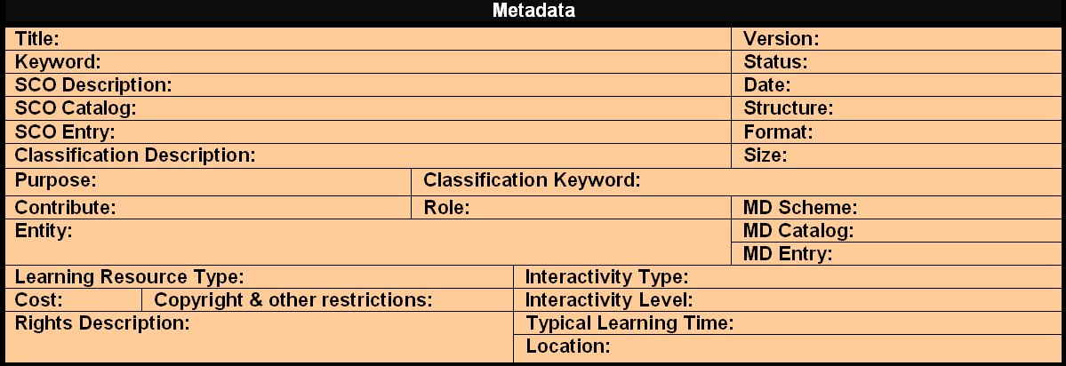
Standardize Authoring Tools
See pages 16 – 20 of the SCORM Best Practices Guide for Content Developers for more information on metadata.

Slide 24
What do you need to know (and do) before designing SCORM content?

Slide 25
Two Primary Considerations for Size
Reusability
  Smaller pieces are more likely to be reusable than larger ones
  Smaller pieces mean more sequencing and more interaction with the LMS for the learner
Tracking
  A SCO is the smallest item tracked in SCORM
  If you don’t need detailed information about the learner’s performance, your SCOs can be bigger

Slide 26
Tracking Requirements
Only SCOs are tracked in the LMS
  Do you need to know if the learner can
    Identify treatment protocols for xyz
    Or
    Identify treatment protocols for xyz in
    patients with pqr
    Or
    Identify treatment protocols for xyz in
    pediatric patients with pqr and efg

Slide 27
Reusability Requirements
If you build “identify treatment protocols for xyz in pediatric patients with pqr and efg”
  Are you optimizing the reuse of your content?
  Will the metadata attract anyone besides pediatricians who specialize in pqr and efg?

Slide 28
Other Things to Consider
What are your assessment requirements?
Do you require remediation if the learner fails an assessment?
Will the learner have choice over the content they see, or will you prescribe the order in which they see it?
Do you want to adapt the learner’s experience based on their choices or decisions?

Slide 29
SCORM-compliant LMSs
Track items only at the SCO level
Multiple levels of conformance
  Relate to how many of the optional SCORM features are included by the vendor
  Particularly important with SCORM 1.2

Slide 30
SCORM 1.2 Data Elements
Not all data elements were required
Creates problems with interoperability
  If you choose to use the proprietary functionality of an LMS
  If you choose to use an optional function not incorporated in all LMSs

Slide 31
SCORM-compliant LMSs
Each LMS has its own interface
  Look and feel will be unique
  Some can be customized for your applications
  Navigation is not standardized

Slide 32
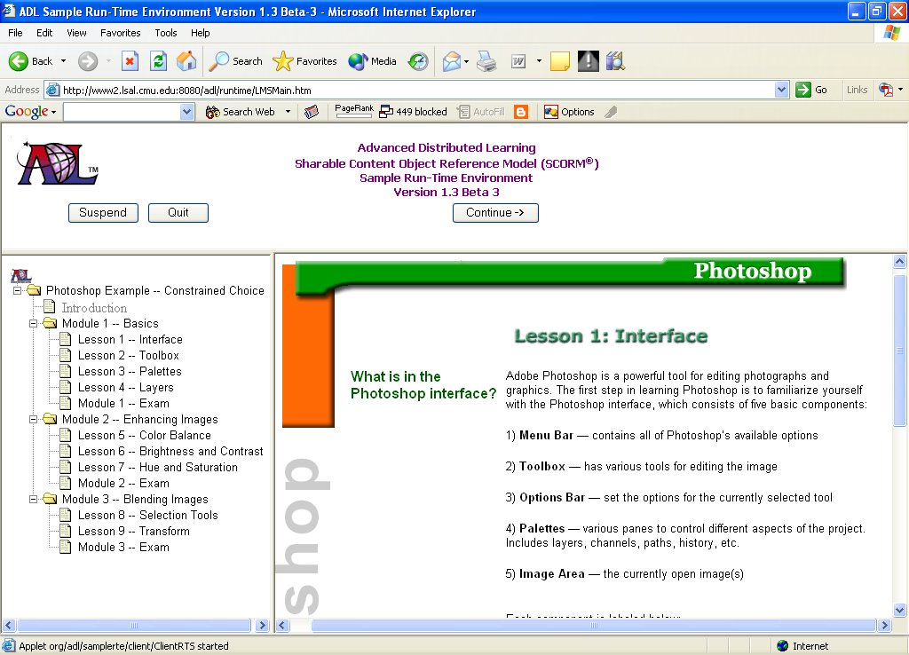

Slide 33
Ask Your LMS/LCMS Vendor
Questions Related to SCORM
  With which version of SCORM does your product comply?
  Has your product passed the ADL Certification Test?
  How active is your company in the design and development of learning standards?
  In which Plugfest did your company last participate?

Slide 34
Ask Your LMS/LCMS Vendor
Questions Related to the LMS
  Can the interface be customized?
  What level of customization is possible?
  How is the table of contents rendered in the LMS?
  Is it possible to play the content full screen or only in a window?

Slide 35
Policies and Procedures
SCORM is very complicated and highly technical
Applying some “constraints” to your team & your project will help you to succeed
  Decrease production time
  Increase ROI

Slide 36
Policies and Procedures
Determine what your team will / won’t do with your instructional materials
Standardize your processes and workflow
Document your policies and procedures in a Style Guide

Slide 37
Policies and Procedures
Style Guide should include
  Definitions of roles/responsibilities
  What you will/won’t do
  Acceptable layouts/interfaces/file types
  Standard file names & conventions
  Version/revision tracking policies
  Metadata field requirements
  Standardized design and development tools

Slide 38
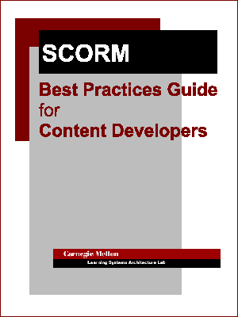
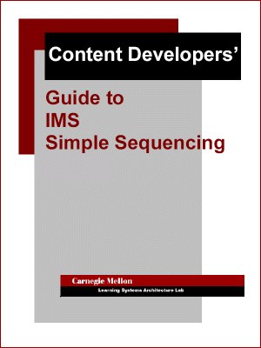
Sample Guidelines

Slide 39
How do you design good SCORM content?
For the medical community?

Slide 40
Ensure Instructional Integrity
Good content makes good
SCORM content
Follow the same good design rules
you always have
Make your SCOs stand-alone
Specify the relationships between SCOs
  Now possible with sequencing

Slide 41
Make Content Compelling
Ask users what they want to experience
  And how they want to experience it
Use appropriate multimedia when appropriate
Give learners control as often as possible
Be succinct – e-learning is not supposed to read, it is supposed to be experienced
Separate need to know from nice to know

Slide 42
Redesigning a “Course” for SCORM
Many organizations are now taking their existing content and converting it to SCORM
REMEMBER
  Good content makes good SCORM content
  SCORM doesn’t require sophisticated presentation techniques
Rule of Thumb
  One learning objective = one SCO

Slide 43
Designing a “Course” for SCORM
Evaluate first (reverse engineering)
  Does the content teach the objectives?
    Are the objectives valid and well written for many contexts?
    Does new content need to be added to teach crucial objectives?
  Is there content in the course that does not address an objective?
    Do you need to add objectives for crucial content?
    Should you remove irrelevant content?

Slide 44
Designing a “Course” for SCORM
Analyze (reverse engineering)
  Who are all the possible audiences that might be interested in this type of content?
  How should we “divide” the content to make each piece of content reusable?
    How low should you go? (learning objects)
  How do we ensure that when we “divide” the content, it is still instructionally sound?

Slide 45
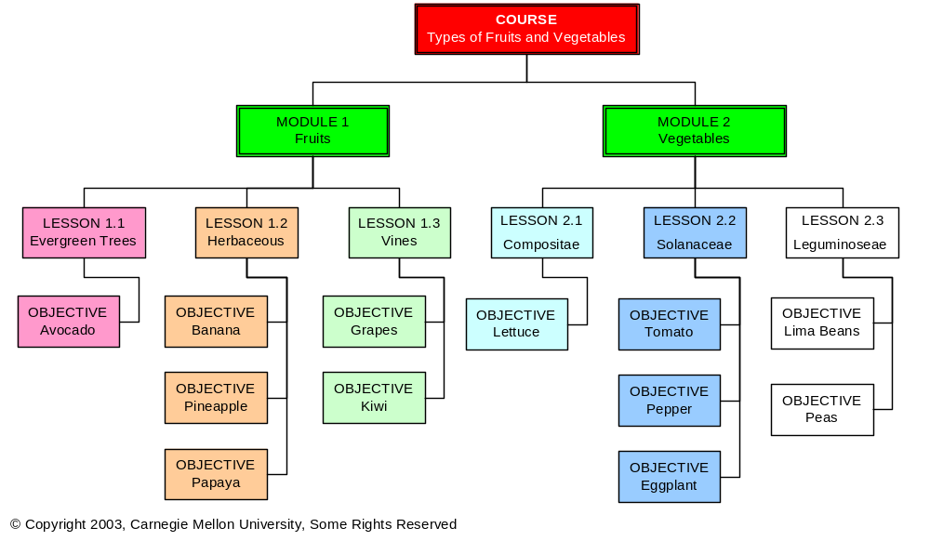
Existing Content Structure

Slide 46
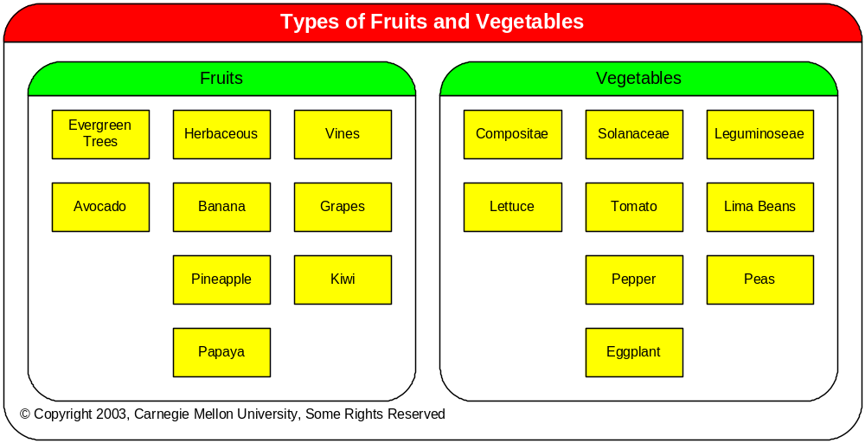
Identifying SCOs from Existing Content

Slide 47
What About Right-Sizing the SCOs?

Slide 48
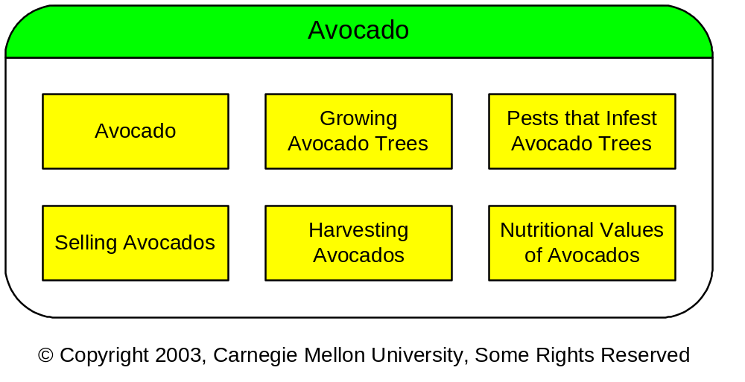
Determining the Right Size for SCOs

Slide 49
What does sequencing mean to content design?

Slide 50
Sequencing
Describes and prescribes the manner in which the learner receives the content
In SCORM, the LMS sequences all activities between the sharable content objects (SCOs) and the learner

Slide 51
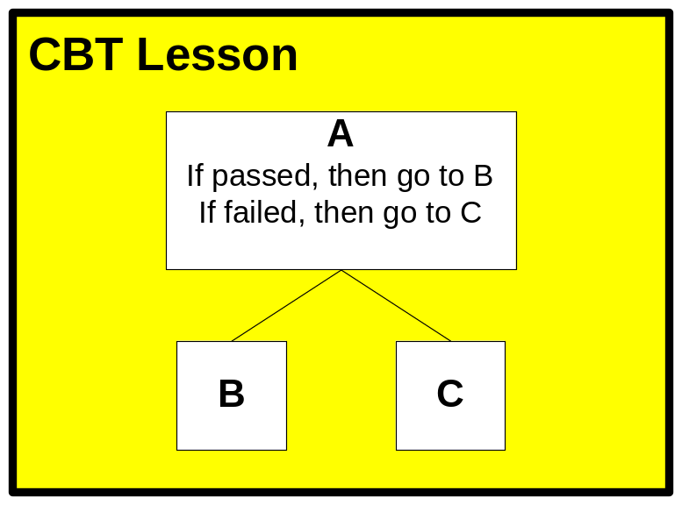
Branching in CBT

Slide 52
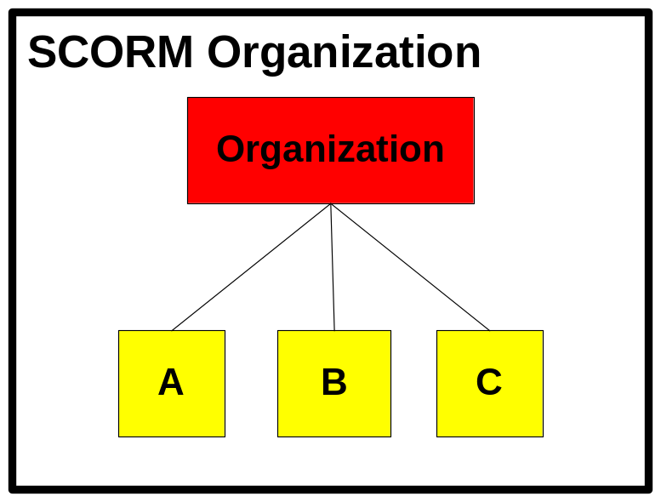
Content Presentation in SCORM 1.2
Notes:
In SCORM 1.2, it was up to each individual LMS to determine how the content was presented to the learner.

Slide 53
Simple Sequencing in SCORM 2004
Start at A and proceed in order
If A is passed, then hide C
If A is failed, then hide B

Slide 54
Traditional Course Content Structure

Slide 55
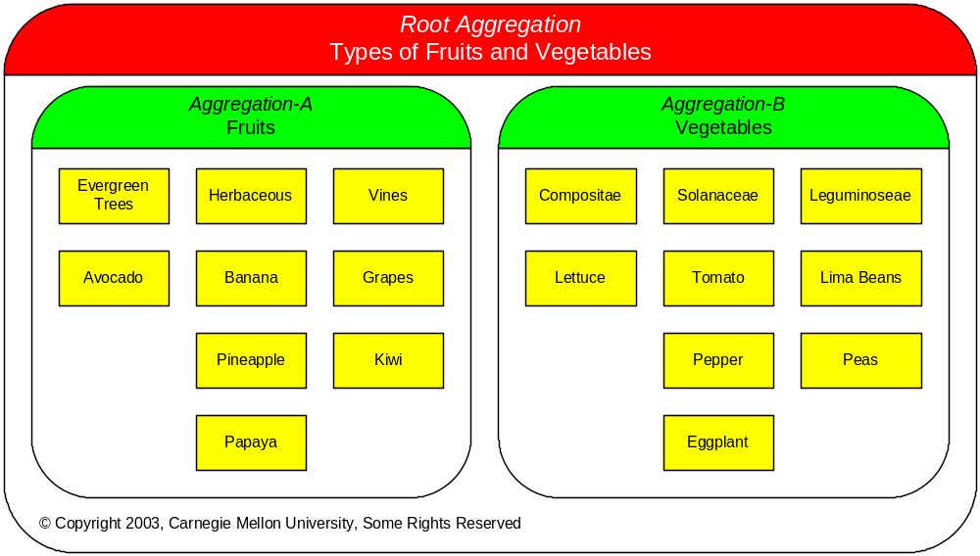
Organizing the SCOs

Slide 56
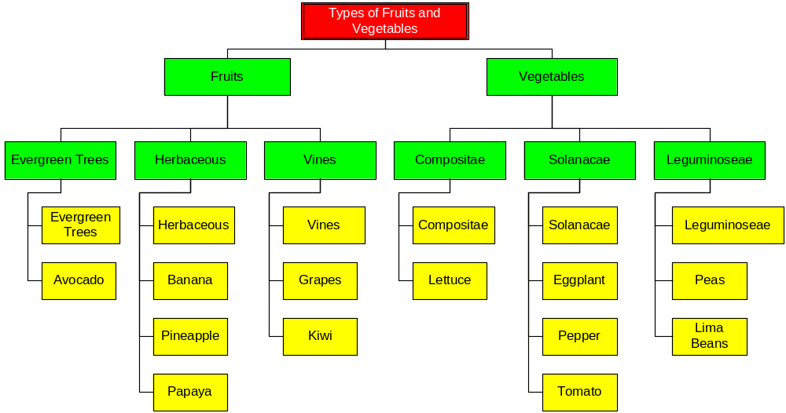
Partial Content Structure Diagram

Slide 57
What About These SCOs?

Slide 58
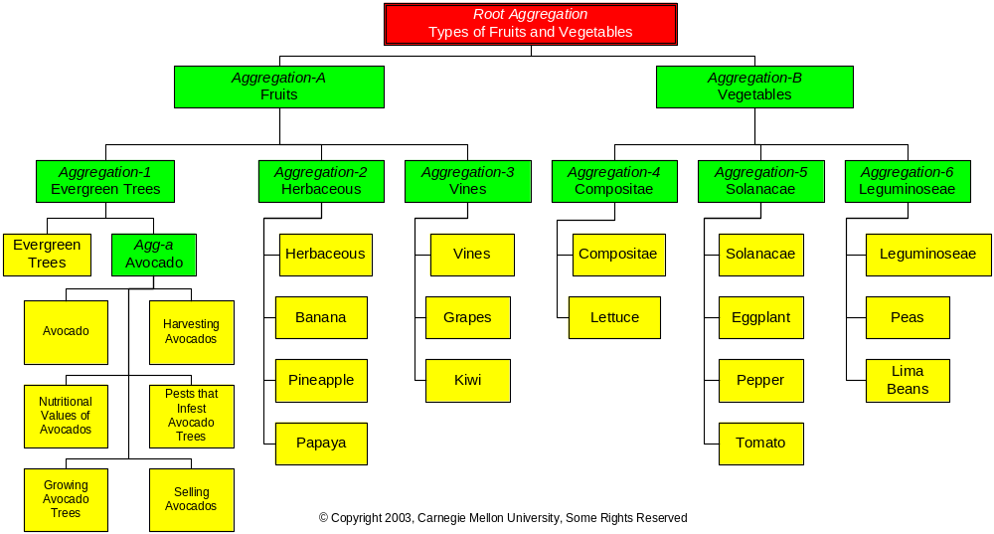
The New Content Structure

Slide 59
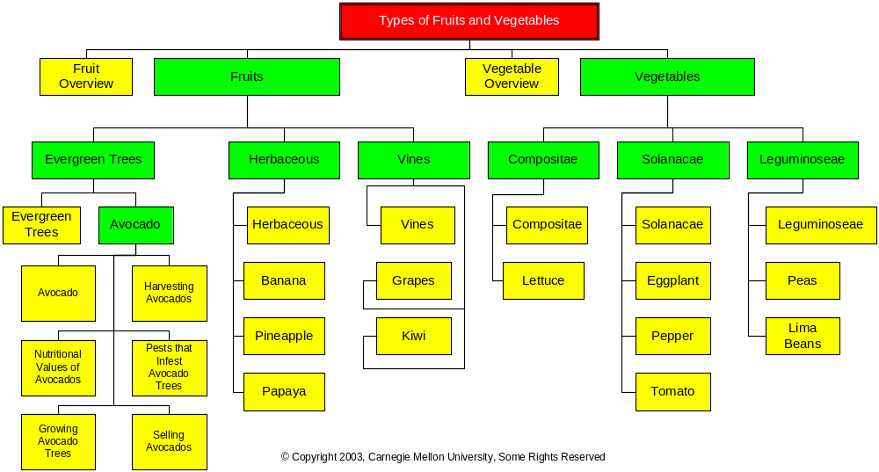
Optional Structures (1)

Slide 60
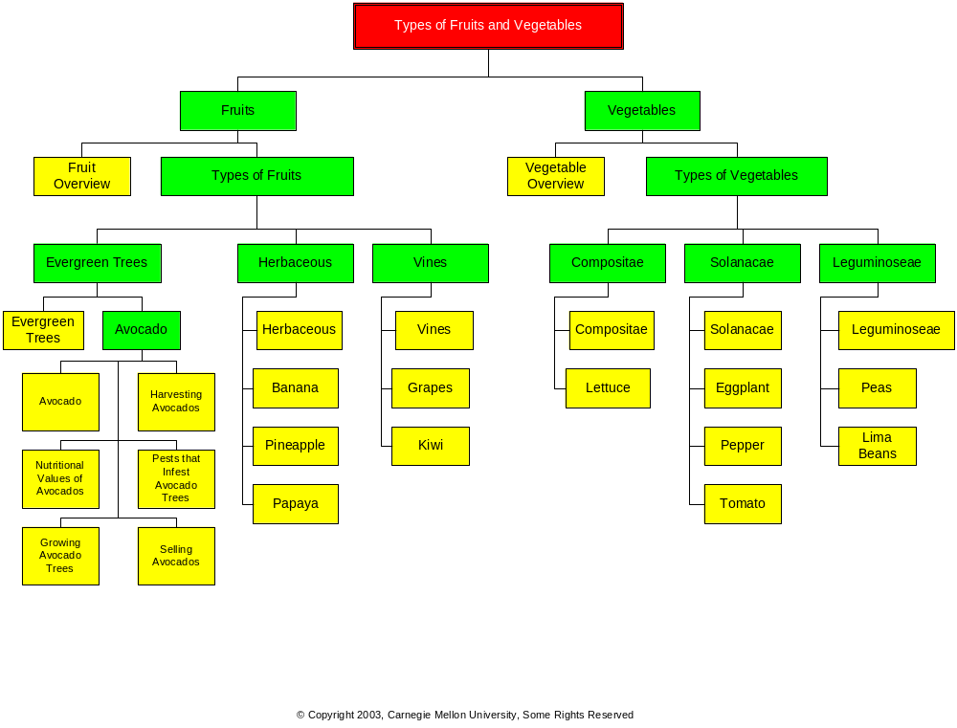
Optional Structures (2)

Slide 61
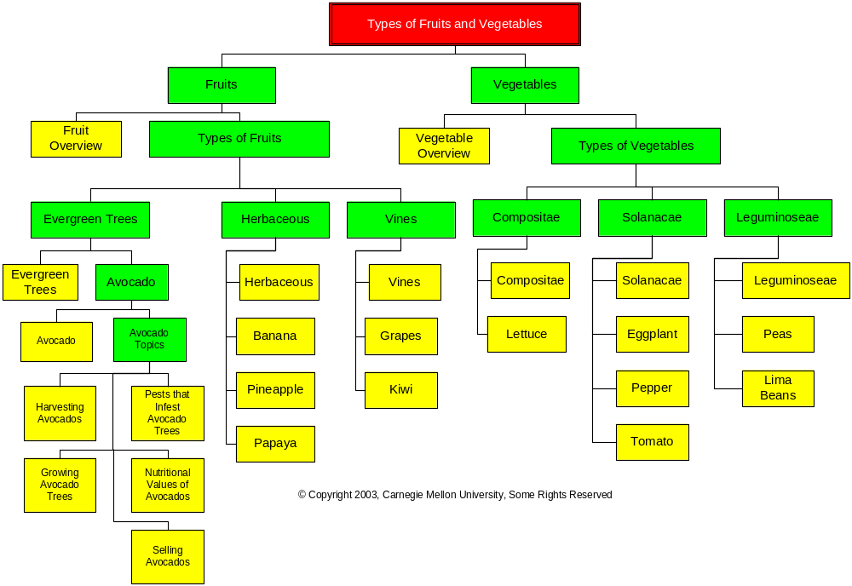
Optional Structures (3)

Slide 62
Objectives
Shared “objectives” (completion/score) allow the state of one activity to affect (read/write) the state of another activity
An objective in sequencing is a shared global variable, not a learning objective
Activity to objective mapping is many to many
  Objectives are shared among Activities
  An Activity can be associated with multiple Objectives

Slide 63
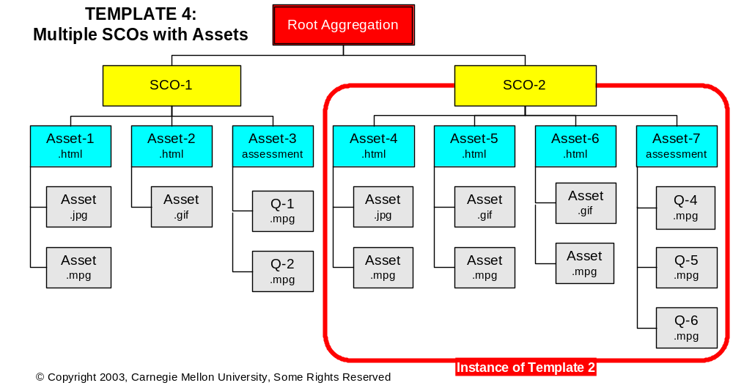
Sequencing Template 4

Slide 64
Rules for Template 4
Template 4 Rules
Behaviors | SCORM Function
To complete the root aggregation, the learner must complete SCO-1 and SCO-2. | Rollup: All: satisfied, completed.
To complete each SCO, the learner must complete the assessments within the SCOs. | No SCORM function needed.
The learner cannot start SCO-2 until SCO-1 is complete. | SCO-1: If Not complete, Deny Forward Progress
The learner can return to SCO-1 from SCO-2 at any time. | Root Aggregation: Forward Only=false

Slide 65
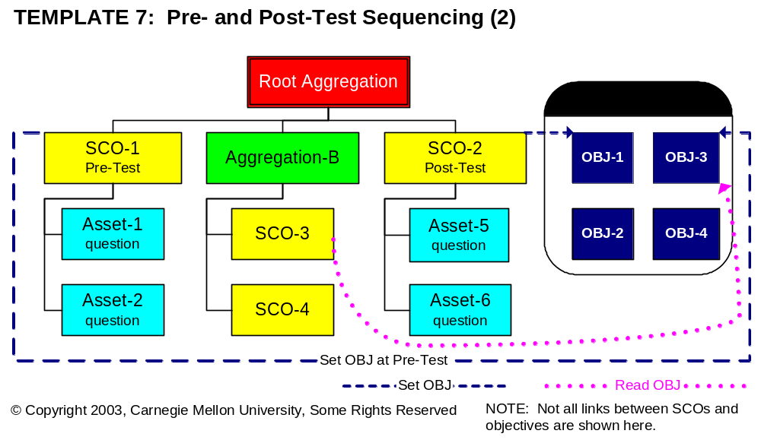
Sequencing Template 7

Slide 66
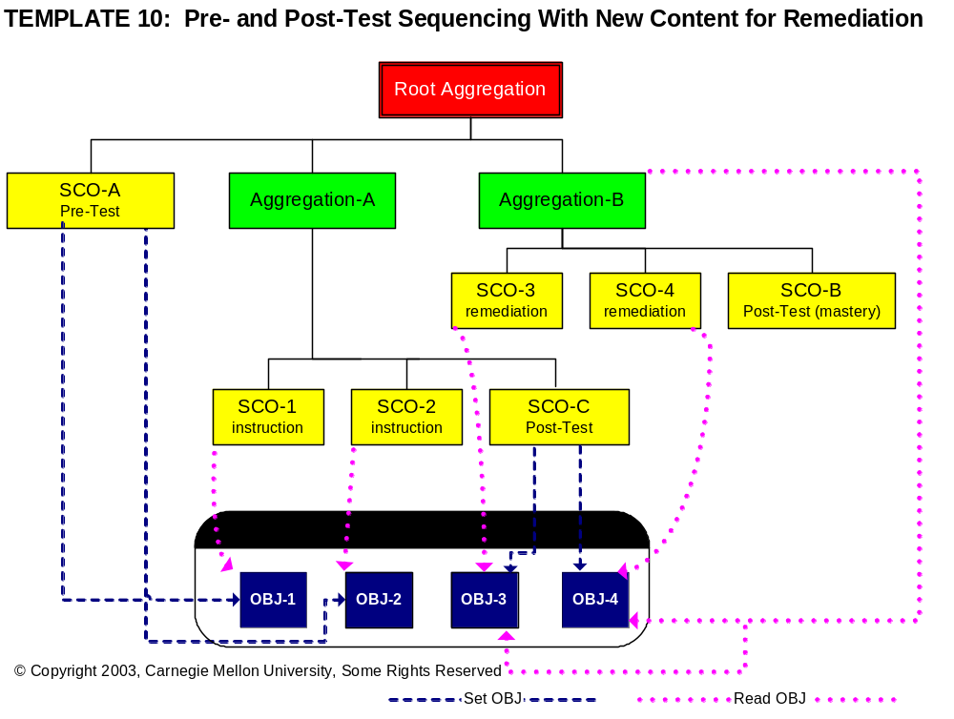
Sequencing Template 10

Slide 67
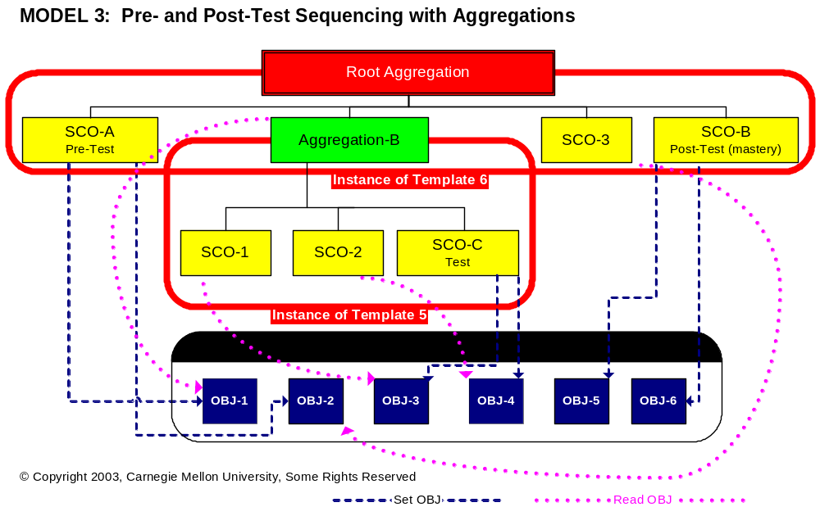
Sequencing Model 3

Slide 68
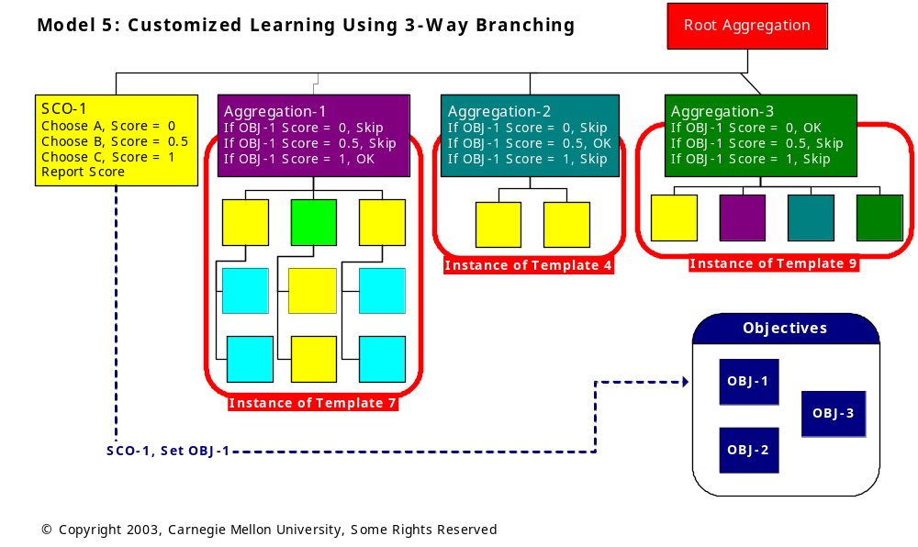
Sequencing Model 5

Slide 69
Packaging Your
SCORM Content

Slide 70
Content Package
A standardized way to exchange collections of digital resources
Everything needed to deliver the course, module, lesson, etc. to the learner

Slide 71
SCORM Content Packaging
The process of getting all the work you’ve done (all of the pieces) into any SCORM-compliant LMS for delivery to a learner.
This results in a collection of files that you can put on a CD.

Slide 72
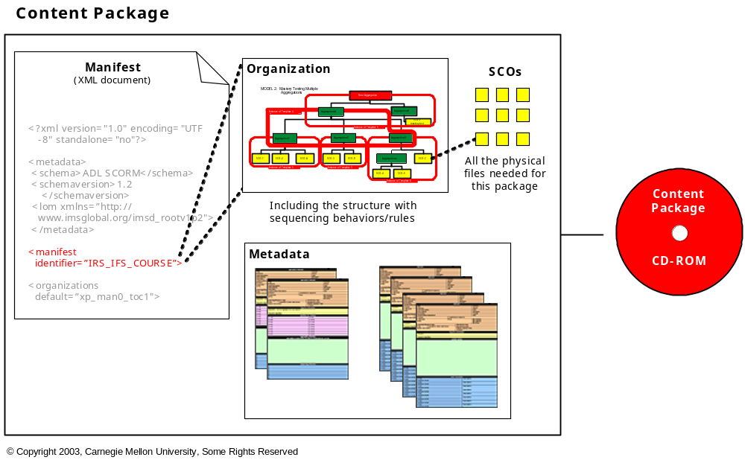
Parts of the Content Package

Slide 73
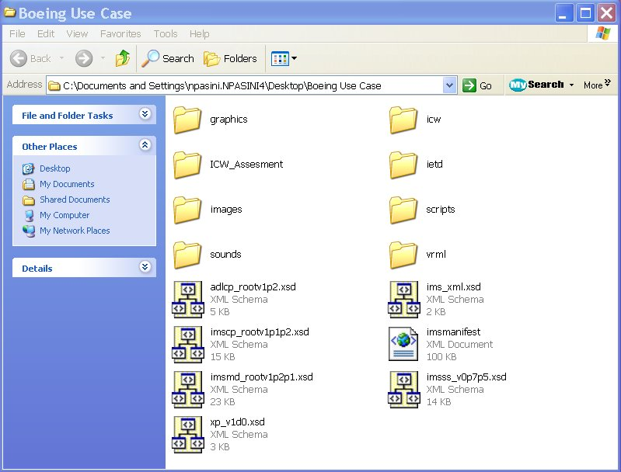
Content Package Files (SCORM 1.2)

Slide 74
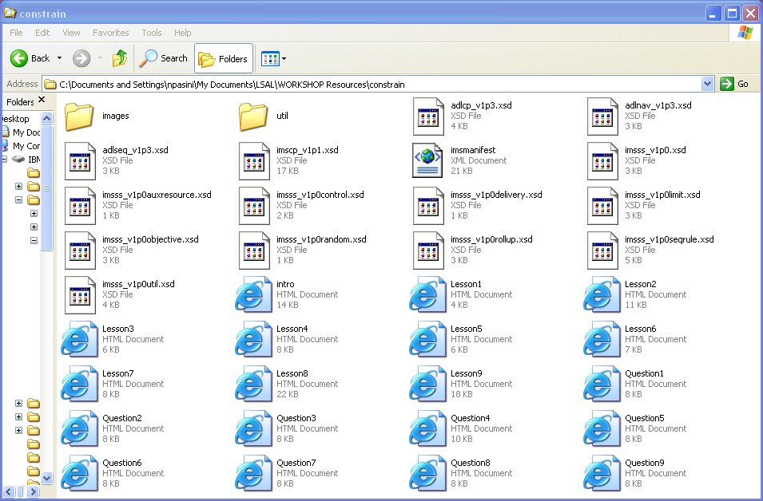
Content Package Files (SCORM 2004)

Slide 75
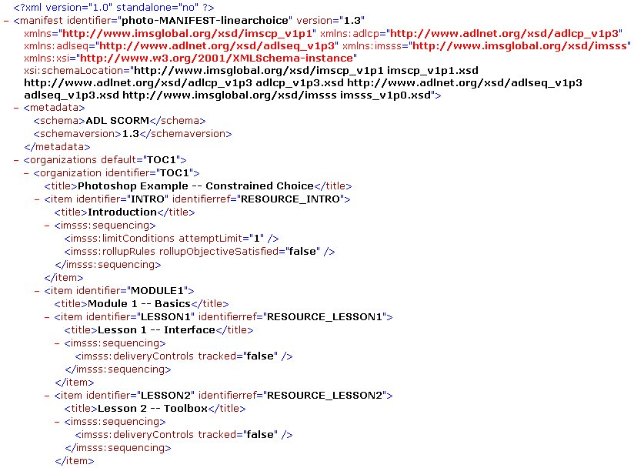
Example of a Manifest (XML)

Slide 76
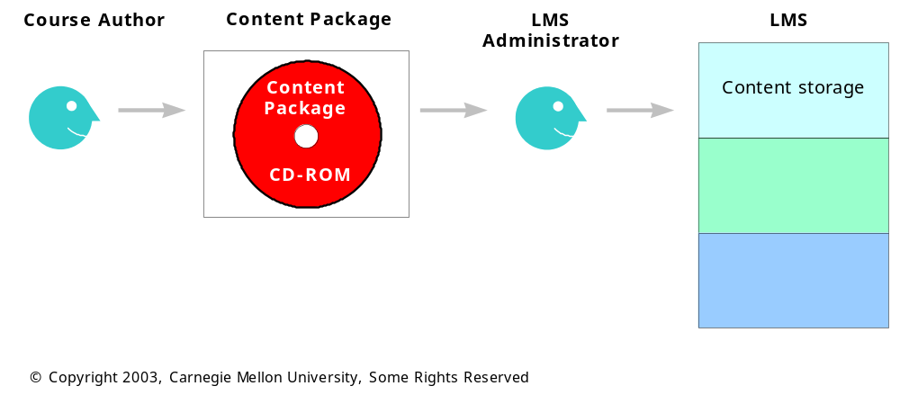
Ideal Content Packaging Process
1. Load content package into LMS

Slide 77
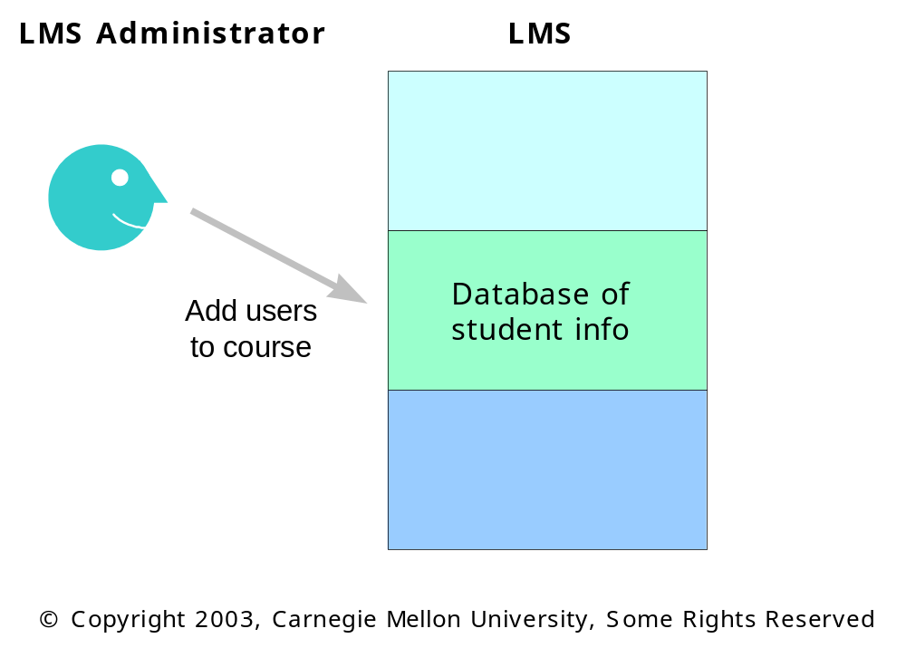
Ideal Content Packaging Process
2. Add learner information and register for course

Slide 78
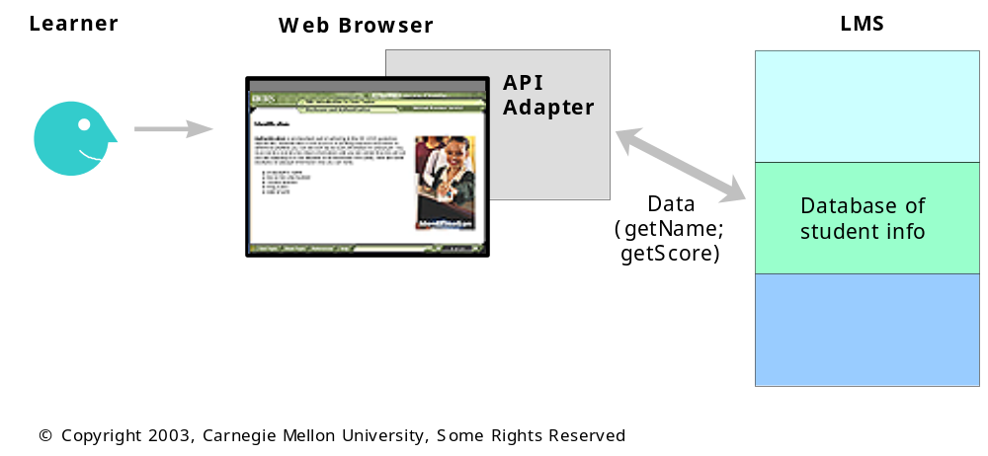
Ideal Content Packaging Process
3. Deliver and Test Interactions

Slide 79
Questions?
For more information:
http://www.lsal.cmu.edu/
http://lsal.org/
lsal@cmu.edu

